Slide 1

Innovation & Strategic Excellence in a Company
Sameer Kothare 63
Prathamesh Pawar 54
Himanshu Satpute 46
Pratik Kamble 56
Harsh Sahare 45
RP

Slide 2
Innovation & Strategic Excellence in a Company
Innovation is vital for businesses to remain competitive and adapt to rapidly changing market landscapes. It is about generating new ideas and solutions that provide value to customers and help organizations stay ahead of the curve.
RP

Slide 3

Defining Innovation: Embracing Creativity and Disruption
New Ideas & Solutions
Challenging the Status Quo
Experimentation & Learning
Innovation involves developing new products, services, processes, or business models that meet evolving customer needs and market demands.
Innovation often involves questioning existing practices, processes, and assumptions to identify opportunities for improvement and disruption.
Innovation requires a willingness to experiment with new ideas, learn from failures, and iterate solutions based on feedback and data.

Slide 4
Aligning Innovation with Strategic Objectives
Business Goals
Market Opportunities
Resource Allocation
Innovation should be aligned with the organization's overall strategic objectives, ensuring that it contributes to achieving key business goals.
Innovation efforts should be focused on addressing key market trends, customer needs, and emerging opportunities to maximize their impact.
Organizations need to prioritize and allocate resources effectively to support innovation initiatives, ensuring that they have the necessary funding, talent, and infrastructure.

Slide 5

Fostering a Culture of Innovation
1
Open Communication
2
Experimentation & Risk-Taking
Encourage open communication and collaboration, allowing employees to share ideas, provide feedback, and learn from each other.
Create a safe space for employees to experiment with new ideas and take calculated risks, fostering a culture of continuous improvement and learning.
3
Recognition & Rewards
4
Leadership Support
Recognize and reward innovative contributions, providing incentives and encouragement to motivate employees to continue generating creative solutions.
Leaders play a crucial role in fostering a culture of innovation by championing new ideas, providing resources, and creating an environment that encourages risk-taking.

Slide 6




Implementing Agile Methodologies
Rapid Prototyping
Agile methodologies allow for rapid prototyping and iteration, enabling teams to quickly test and refine ideas based on feedback and data.
Continuous Improvement
Agile processes emphasize continuous improvement, with regular retrospectives and adjustments to optimize workflows and enhance performance.
Cross-Functional Teams
Agile teams are typically cross-functional, bringing together individuals with diverse skills and perspectives to collaborate effectively on projects.

Slide 7



Leveraging Emerging Technologies
Virtual Reality & Augmented Reality
Data Analytics & Machine Learning
Automation & Robotics
Automation and robotics can streamline processes, improve efficiency, and enhance productivity in various industries.
VR and AR technologies can create immersive experiences for product demonstrations, training, and customer engagement.
Data analytics and machine learning algorithms can identify patterns, predict outcomes, and inform decision-making processes.

Slide 8
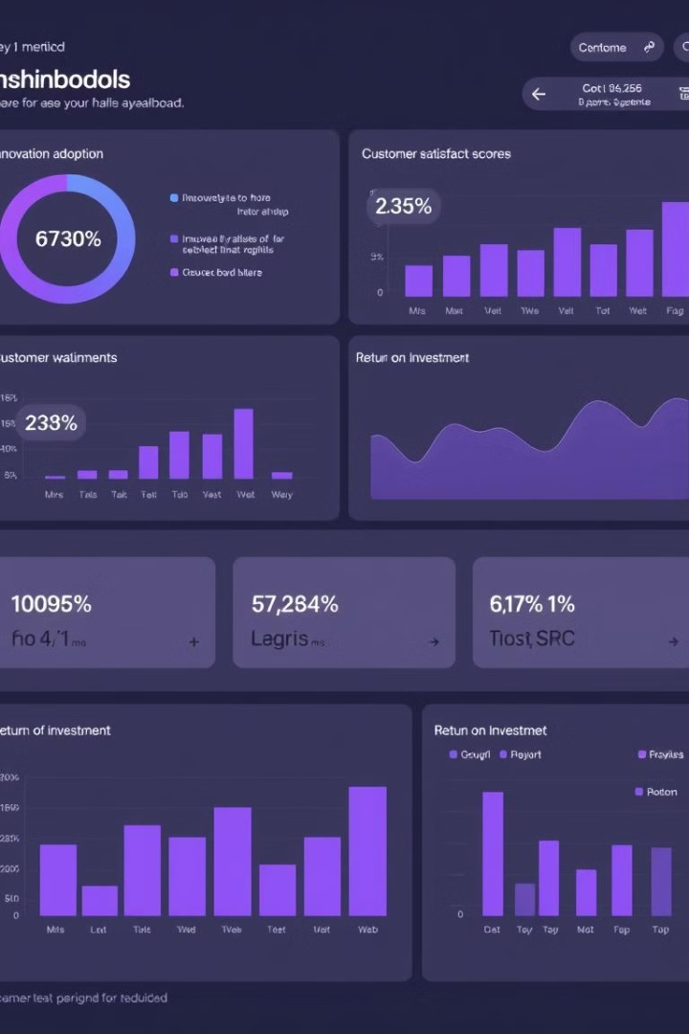
Measuring and Optimizing Innovation Outcomes
Metric
Description
Measurement Method
Innovation Adoption Rate
The percentage of customers or employees who have adopted a new product, service, or process.
Track the number of users or adopters over time.
Customer Satisfaction Score
A measure of customer satisfaction with the new innovation.
Conduct surveys, collect feedback, and analyze reviews.
Return on Investment (ROI)
The financial benefits generated by the innovation, compared to the costs incurred.
Calculate the financial impact of the innovation and compare it to the initial investment.

Slide 9

Sustaining Innovation: Overcoming Challenges and Driving Continuous Improvement
Adapting to Change
1
Continuously monitor the market and adapt to emerging trends, customer needs, and competitive pressures to ensure that innovations remain relevant.
2
Overcoming Resistance
Address resistance to change by clearly communicating the benefits of innovation, providing training and support, and celebrating successes.
Investing in Talent
3
Invest in developing the skills and knowledge of employees, fostering a culture of lifelong learning and innovation.
4
Encouraging Feedback
Encourage open feedback and suggestions from employees, customers, and stakeholders to identify areas for improvement and enhance innovation efforts.

Slide 10

Innovation is Key to Success
In today's dynamic business landscape, embracing innovation is not just an option, but a necessity. By fostering a culture of creativity, experimentation, and strategic thinking, organizations can unlock their full potential and drive sustainable growth.

Slide 11

Conclusion & Summary
Key Takeaways:
Innovation as a Competitive Advantage
Innovation is critical for sustaining long-term growth and maintaining a competitive edge in a rapidly evolving marketplace.
Current Innovation Trends
Sustainability, digital transformation, and AI integration are reshaping industries and creating new opportunities for innovation.
Strategic Approach
A combination of R&D, partnerships, and technology adoption forms the core of a successful innovation strategy, driving measurable outcomes like increased market share and product enhancement.
Real-World Examples
Case studies from the tech and manufacturing sectors illustrate how innovation can drive significant business impact, both in terms of market positioning and operational efficiency.
Next Steps:
Foster a culture of innovation by encouraging brainstorming sessions and adopting agile processes.
Implement the short-, medium-, and long-term innovation initiatives outlined in the timeline.
Regularly measure innovation success through metrics like ROI, speed to market, and customer satisfaction.

Slide 12
Thank You

